Slide 1
Deep Learning
Lecture 4
Introduction to Neural Networks
Dr. Muhammad Jawad Khan
Robotics and Intelligent Machine Engineering Department,
School of Mechanical and Manufacturing,
National University of Sciences and Technology,
Islamabad, Pakistan.
\

Slide 2




Where we are...
scores function
SVM loss
data loss + regularization
want

Slide 3

Gradient Descent
Numerical gradient: slow :(, approximate :(, easy to write :)
Analytic gradient: fast :), exact :), error-prone :(
In practice: Derive analytic gradient, check your implementation with numerical gradient

Slide 4


Computational Graph
x
*
s (scores)
hinge loss
+
L
W
R

Slide 5
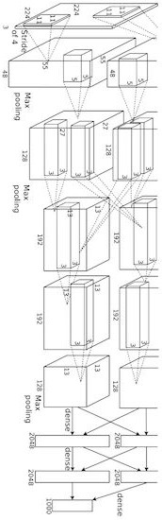
Convolutional Network (AlexNet)
input image weights
loss

Slide 6
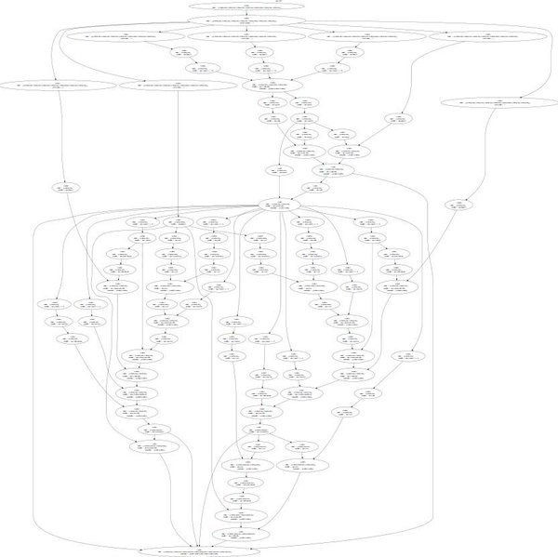
Neural Turing Machine
input tape
loss

Slide 7
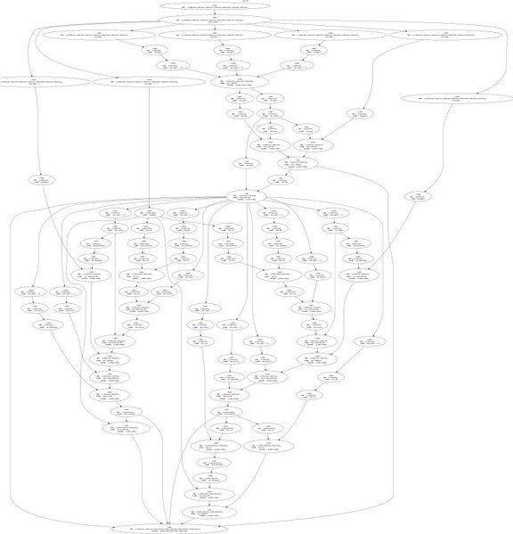
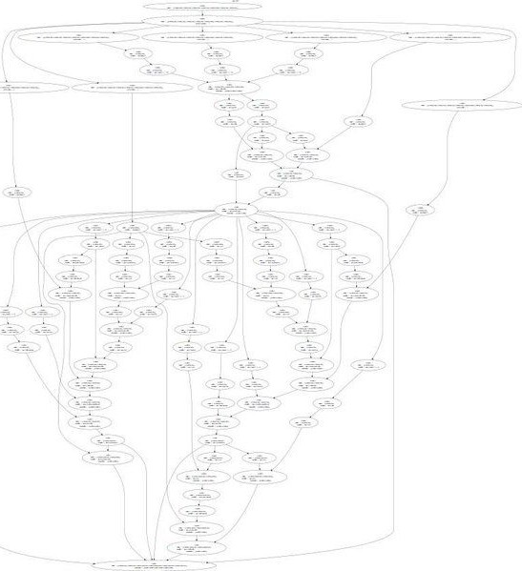
Neural Turing Machine

Slide 8

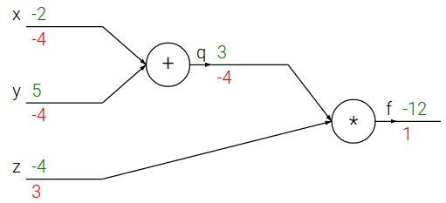
e.g. x = -2, y = 5, z = -4

Slide 9





e.g. x = -2, y = 5, z = -4
Want:

Slide 10

e.g. x = -2, y = 5, z = -4
Want:

Slide 11
e.g. x = -2, y = 5, z = -4
Want:

Slide 12

e.g. x = -2, y = 5, z = -4
Want:

Slide 13
e.g. x = -2, y = 5, z = -4
Want:

Slide 14

e.g. x = -2, y = 5, z = -4
Want:

Slide 15
e.g. x = -2, y = 5, z = -4
Want:

Slide 16

e.g. x = -2, y = 5, z = -4
Want:

Slide 17


e.g. x = -2, y = 5, z = -4
Chain rule:
Want:

Slide 18

e.g. x = -2, y = 5, z = -4
Want:

Slide 19
e.g. x = -2, y = 5, z = -4
Chain rule:
Want:

Slide 20


activations
f

Slide 21


activations
“local gradient”
f

Slide 22

activations
“local gradient”
f
gradients

Slide 23
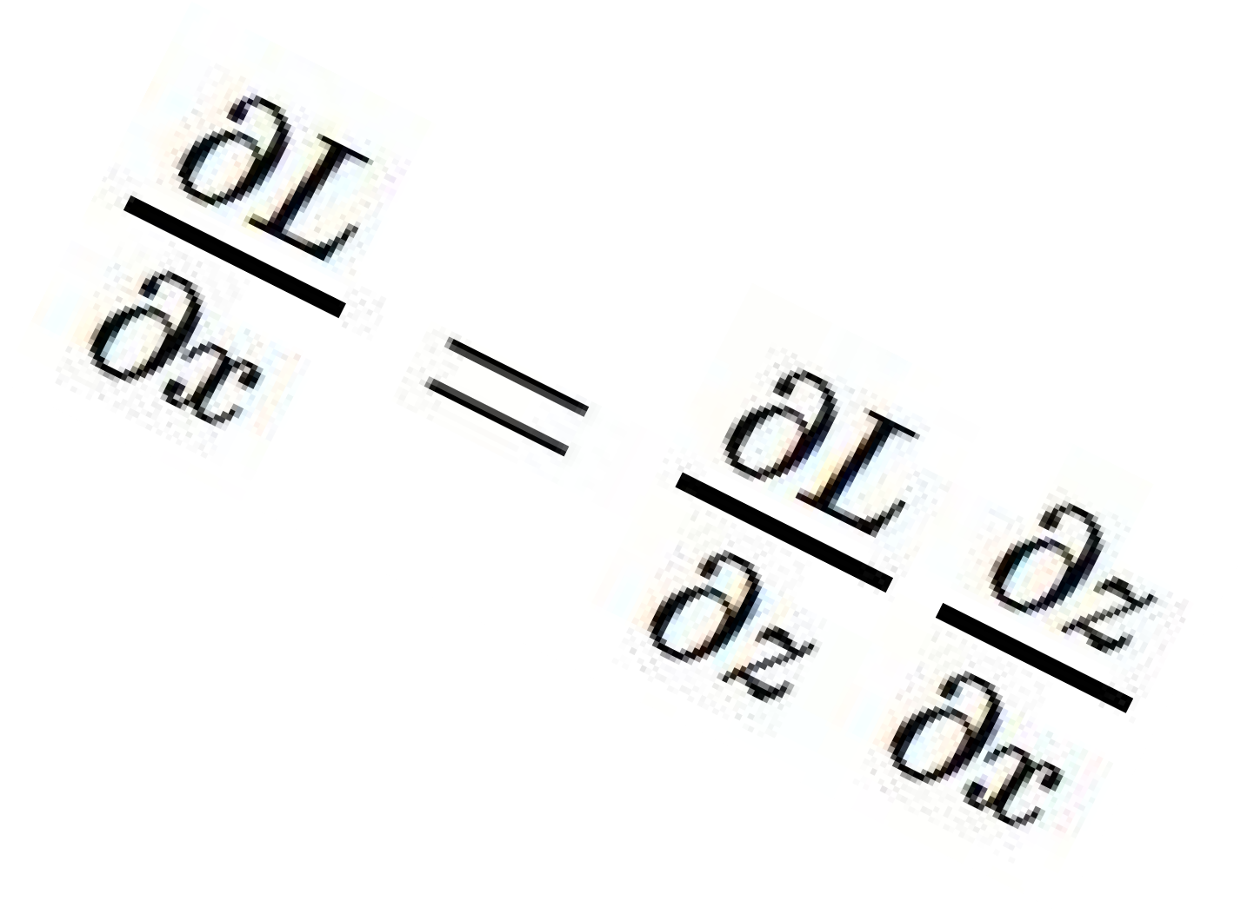
activations
“local gradient”
f
gradients

Slide 24
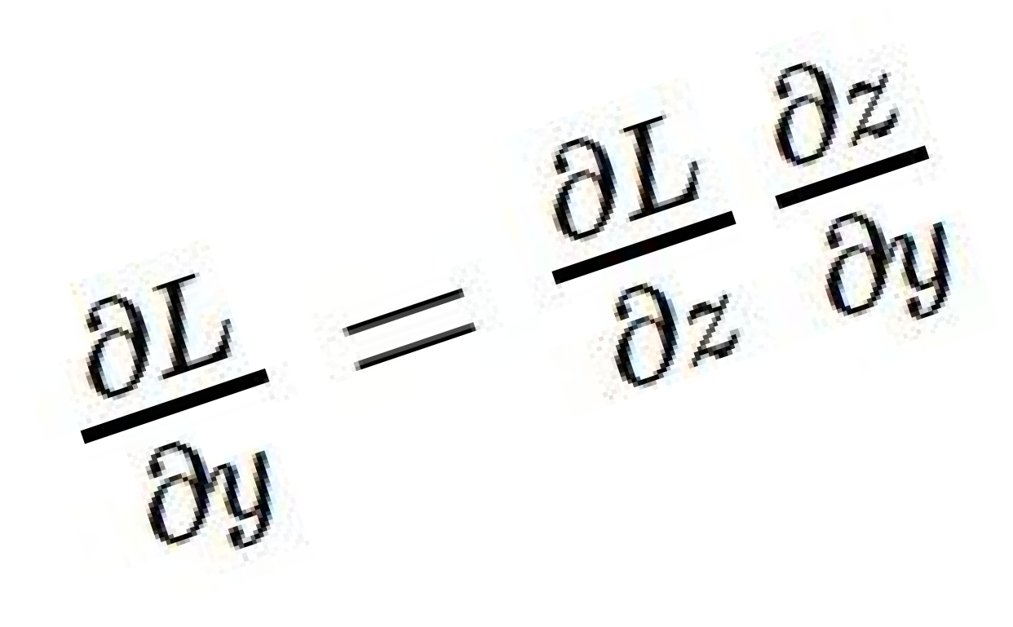
activations
“local gradient”
f
gradients

Slide 25
activations
“local gradient”
f
gradients

Slide 26
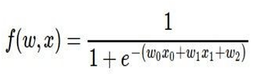
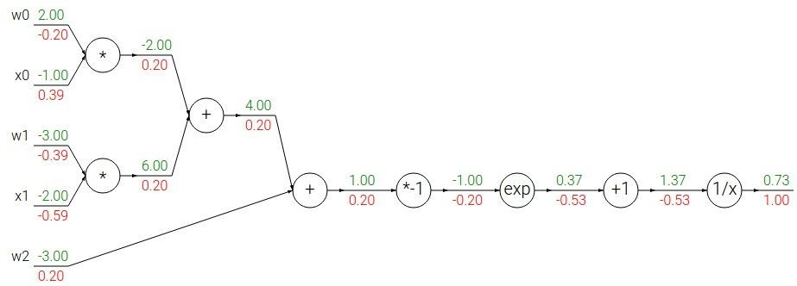
Another example:

Slide 27
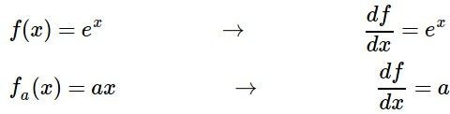
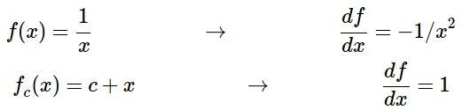
Another example:

Slide 28

Another example:

Slide 29
Another example:

Slide 30

Another example:

Slide 31
Another example:

Slide 32

Another example:

Slide 33
Another example:

Slide 34

Another example:
(-1) * (-0.20) = 0.20

Slide 35
Another example:

Slide 36
Another example:
[local gradient] x [its gradient] [1] x [0.2] = 0.2
[1] x [0.2] = 0.2 (both inputs!)

Slide 37
Another example:

Slide 38
Another example:
[local gradient] x [its gradient] x0: [2] x [0.2] = 0.4
w0: [-1] x [0.2] = -0.2

Slide 39

sigmoid function
sigmoid gate

Slide 40
sigmoid function
sigmoid gate
(0.73) * (1 - 0.73) = 0.2

Slide 41
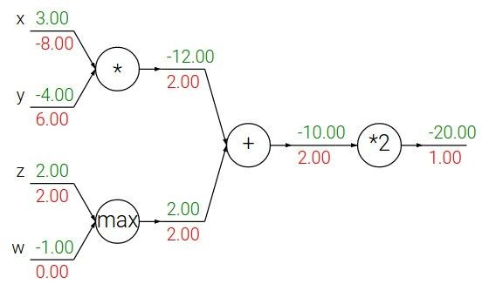
Patterns in backward flow
add gate: gradient distributor
max gate: gradient router
mul gate: gradient… “switcher”?

Slide 42
Gradients add at branches
+

Slide 43
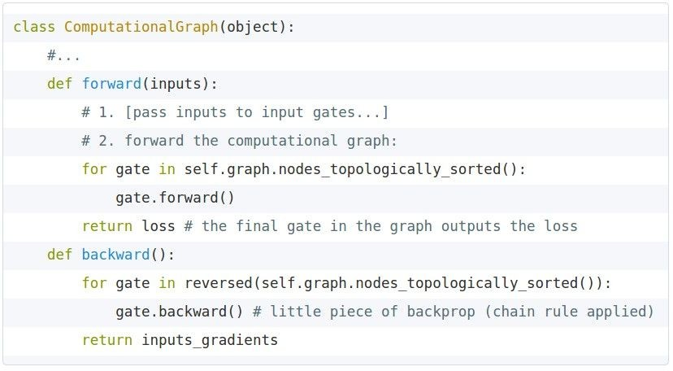
Implementation:
forward/backward API
Graph (or Net) object. (Rough psuedo code)

Slide 44
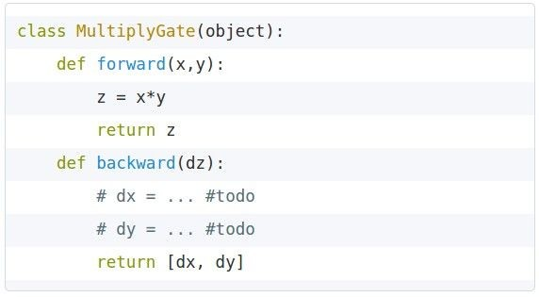


Implementation:
forward/backward API
x
z
*
y
(x,y,z are scalars)

Slide 45
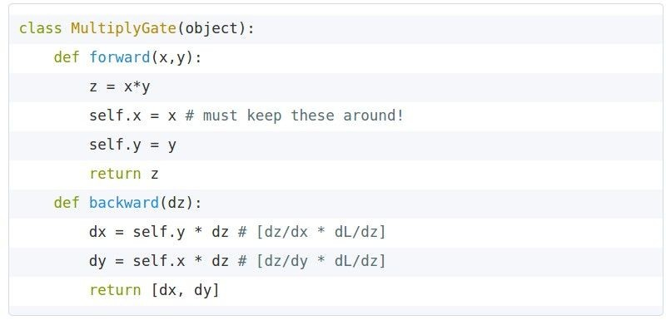
Implementation:
forward/backward API
x
z
*
y
(x,y,z are scalars)

Slide 46

Gradients for vectorized code (x,y,z are now vectors)
This is now the Jacobian matrix (derivative of each element of z w.r.t. each element of x)
“local gradient”
f
gradients

Slide 47
Vectorized operations
f(x) = max(0,x)
(elementwise)
4096-d
input vector
4096-d
output vector

Slide 48

Vectorized operations
f(x) = max(0,x)
(elementwise)
Jacobian matrix
4096-d
input vector
4096-d
output vector
Q: what is the size of the Jacobian matrix?

Slide 49
Vectorized operations
f(x) = max(0,x)
(elementwise)
Jacobian matrix
4096-d
input vector
max(0,x)
(elementwise)
4096-d
output vector
Q: what is the size of the Jacobian matrix? [4096 x 4096!]
Q2: what does it look like?

Slide 50
Vectorized operations
in practice we process an entire minibatch (e.g. 100) of examples at one time:
f(x) = max(0,x)
(elementwise)
100 4096-d
input vectors
max(0,x)
(elementwise)
100 4096-d
output vectors
i.e. Jacobian would technically be a [409,600 x 409,600] matrix :\

Slide 51
Summary so far
neural nets will be very large: no hope of writing down gradient formula by hand for all parameters
backpropagation = recursive application of the chain rule along a computational graph to compute the gradients of all inputs/parameters/intermediates
implementations maintain a graph structure, where the nodes implement the forward() / backward() API.
forward: compute result of an operation and save any intermediates needed for gradient computation in memory
backward: apply the chain rule to compute the gradient of the loss function with respect to the inputs.

Slide 52

Neural Network: without the brain stuff
(Before) Linear score function:

Slide 53

Neural Network: without the brain stuff
(Before) Linear score function:
(Now) 2-layer Neural Network

Slide 54
Neural Network: without the brain stuff
(Before) Linear score function:
(Now) 2-layer Neural Network
x
h
s
W1
W2
3072
100
10

Slide 55

Neural Network: without the brain stuff
(Before) Linear score function:
(Now) 2-layer Neural Network
X
h
W1
W2
s
3072
100
10

Slide 56
Neural Network: without the brain stuff
(Before) Linear score function:
(Now) 2-layer Neural Network or 3-layer Neural Network

Slide 57
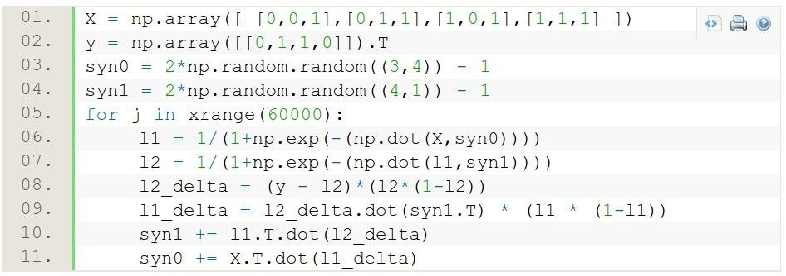
Full implementation of training a 2-layer Neural Network needs ~11 lines:
from @iamtrask, http://iamtrask.github.io/2015/07/12/basic-python-network/

Slide 58
A look at Hidden Layers
What you have studied so far is included as a part of a single perceptron.
What happens when you have multiple perceptrons…
What happens when you have multiple layers of perceptrons…
(hint: perceptrons = neurons)

Slide 59
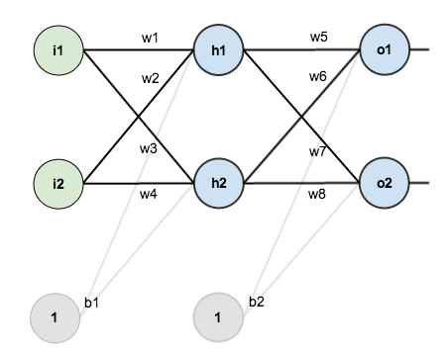
Consider a 2 layer neural network

Slide 60
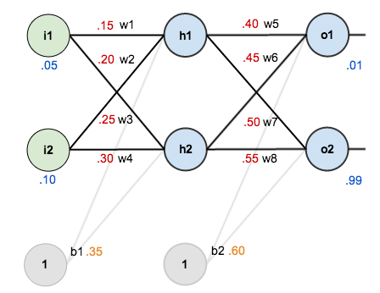
Step 1: Let’s initialize weights and biases for any inputs
Weights and biases have been randomly assigned for now.

Slide 61
Step 2: Propagate through the network to find the outputs (Forward Pass)

Slide 62
Step 2 (continued): How did we calculate the Network Output?
To begin, lets see what the neural network currently predicts given the weights and biases above and inputs of 0.05 and 0.10. To do this we’ll feed those inputs forward though the network.
We figure out the total net input to each hidden layer neuron, squash the total net input using an activation function (here we use the logistic function also known as sigmoid function), then repeat the process with the output layer neurons.

Slide 63
Step 2 (continued): How did we calculate the Network Output?
Here’s how we calculate the total net input for h₁
We then squash it using the logistic function to get the output of h₁:
Similarly we can calculate h₂. (What is it?)

Slide 64
Step 2 (continued): How did we calculate the Network Output?
Continuing onwards. We repeat this process for the output layer neurons, using the output from the hidden layer neurons as inputs. For o₁.
For o₂

Slide 65
Step 3: Loss Calculation.
Recall there are multiple methods for Loss calculation. The total loss is also called total error.
We will be using squared error function or L2 Loss.
We will have to calculate error in both of the network outputs when we are given target outputs.

Slide 66
Step 3: Loss Calculation.
The error for the first output is:
The error for the second output is:
The total error is the sum of both of these individual output errors:

Slide 67
Step 4: The Backwards Pass
We want to calculate the dependence of the Error that we calculated on each and every single weight.
Recall: We want to see how the Error can be minimized by changing the weights.
So we need to find the derivatives of Error with respect to each weight
For a single layer it is relatively straight forward.
For the next layer, however…

Slide 68
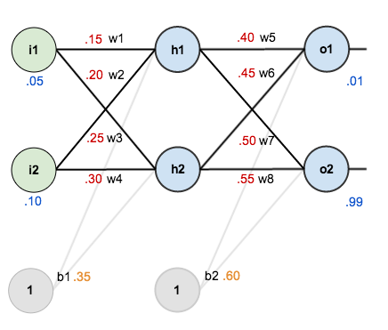
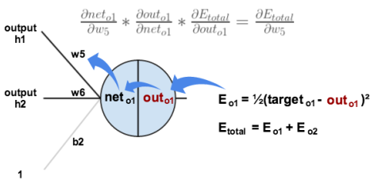
Step 4 (Continued): The Backwards Pass
Error dependence on w5?
Apply the chain rule.

Slide 69
Step 4 (Continued): The Backward Pass
We need to figure out each piece in this equation.
First, how much does the total error change with respect to the output?

Slide 70

Step 4 (Continued): The Backward Pass
Recall: The partial derivative of the logistic function is the output multiplied by 1 minus the output:
Going back even further…

Slide 71
Step 4 (Continued): The Backward Pass
You’ll often see this calculation combined in the form of the delta rule:
To decrease the error, we then subtract this value from the current weight. This is called weight update
We will multiply by some learning rate, etc., which we’ll set to 0.5):

Slide 72
Class Assignment
Calculator time!
Calculate updated weights of w₆, w₇ and w₈

Slide 73
Class Assignment
Calculator time!
Calculate updated weights of w₆, w₇ and w₈

Slide 74
Step 4 (Continued): The Backward Pass through the Hidden Layer
How to update w₁, w₂, w₃ and w₄?
For instance for w₁ what we want is:

Slide 75
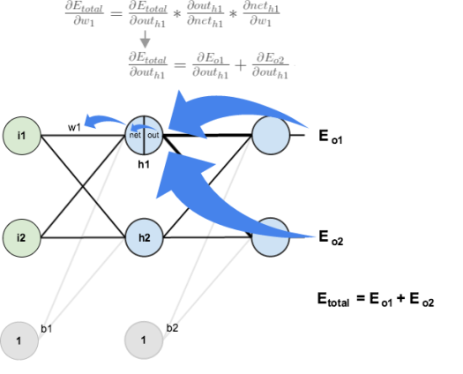
Step 4 (Continued): The Backward Pass through the Hidden Layer
Visually what we want is this:

Slide 76
Step 4 (Continued): The Backward Pass through the Hidden Layer
We’re going to use a similar process as we did for the output layer, but slightly different to account for the fact that the output of each hidden layer neuron is contributing to all the neurons in the subsequent layer.
So:

Slide 77
Step 4 (Continued): The Backward Pass through the Hidden Layer
Continuing:
Plugging them all in:

Slide 78
Step 4 (Continued): The Backward Pass through the Hidden Layer
Similarly:
Therefore:
Moving on, Recall the derivative of sigmoid:
Next:

Slide 79
Step 4 (Continued): The Backward Pass through the Hidden Layer
Putting it all together…(Finally!)
We can update the weight w1 similar to what we did earlier

Slide 80
Hidden weight update
Error with respect to sigmoid (out)
Sigmoid with respect to net
Net with respect to weight w5
Net with respect to weight w7
1st layer update
Error 1 with respect to sigmoid (out)
Sigmoid with respect to net o1
Error 2 with respect to sigmoid (out)
Sigmoid with respect to net o2
Sum
Net wrt sigmoid h1 (out h1)
Out h1 wrt net h1
Net h1 wrt weight w1 (= i1)

Slide 81
Assignment: 2
Calculate the weight updates of w₂, w₃, w₄

Slide 82
Summary
we arrange neurons into fully-connected layers
the abstraction of a layer has the nice property that it allows us to use efficient vectorized code (e.g. matrix multiplies)
neural networks are not really neural
- neural networks: bigger = better (but might have to regularize more strongly)

Slide 84
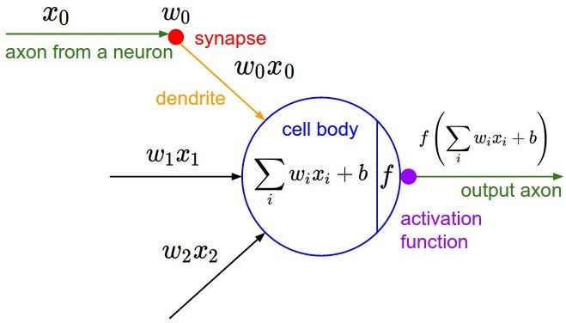

Slide 85
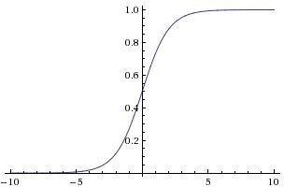

sigmoid activation function

Slide 86
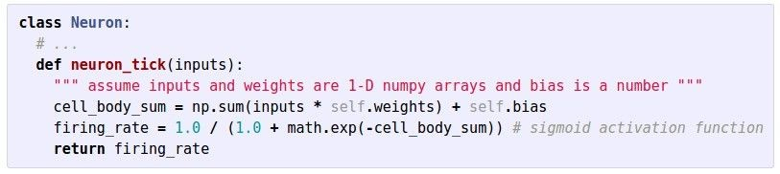

Slide 87
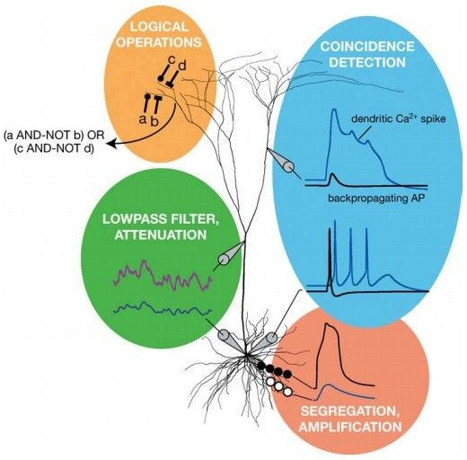
Be very careful with your Brain analogies:
Biological Neurons:
Many different types
Dendrites can perform complex non- linear computations
Synapses are not a single weight but a complex non-linear dynamical system
Rate code may not be adequate
[Dendritic Computation. London and Hausser]

Slide 88
Activation Functions

Slide 89
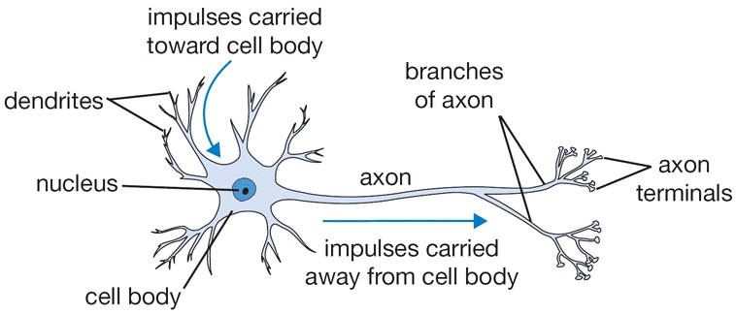
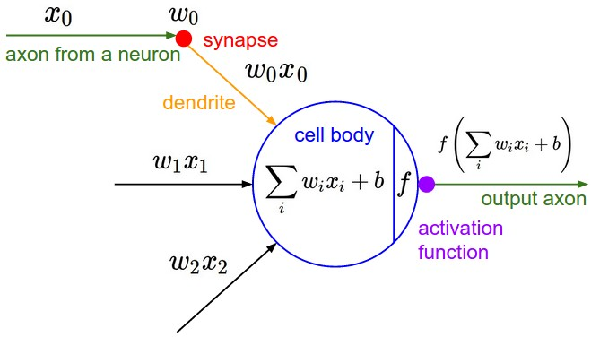
Activation Functions

Slide 90
Activation Functions

Slide 93


Slide 101
Class Assignment

Slide 102
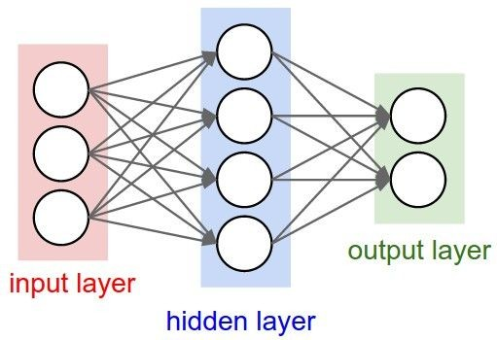
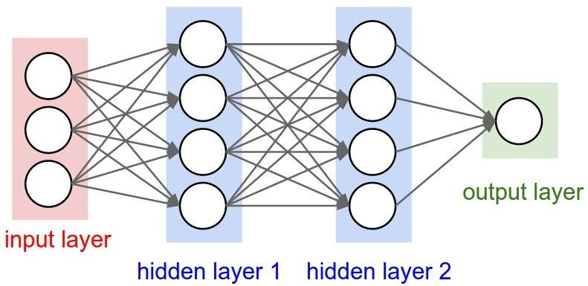
Neural Networks: Architectures
“3-layer Neural Net”, or
“2-hidden-layer Neural Net”
“Fully-connected” layers
“2-layer Neural Net”, or
“1-hidden-layer Neural Net”

Slide 103
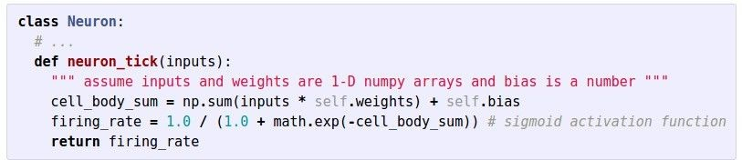
Example Feed-forward computation of a Neural Network
We can efficiently evaluate an entire layer of neurons.

Slide 104
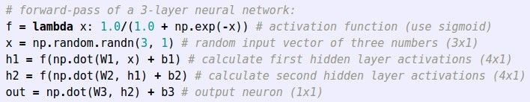
Example Feed-forward computation of a Neural Network

Slide 105
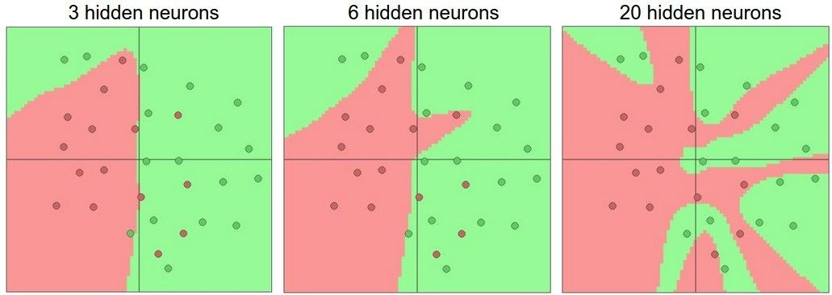
Setting the number of layers and their sizes
more neurons = more capacity

Slide 106
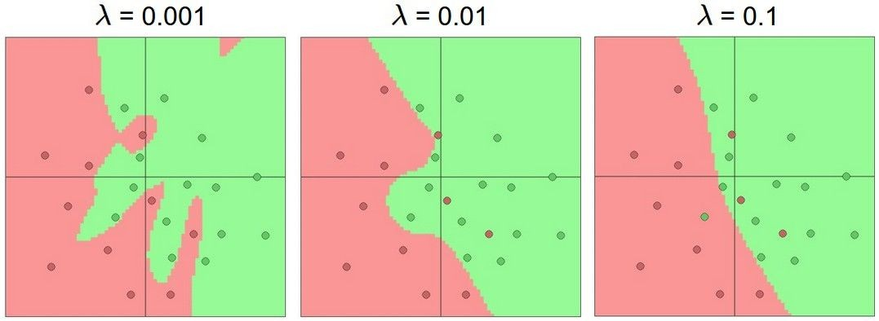
Do not use size of neural network as a regularizer. Use stronger regularization instead:

